Slide 1

Cognitive Computing
Dr. Piyush Joshi
Assistant Professor
IIIT Sri City

Slide 2
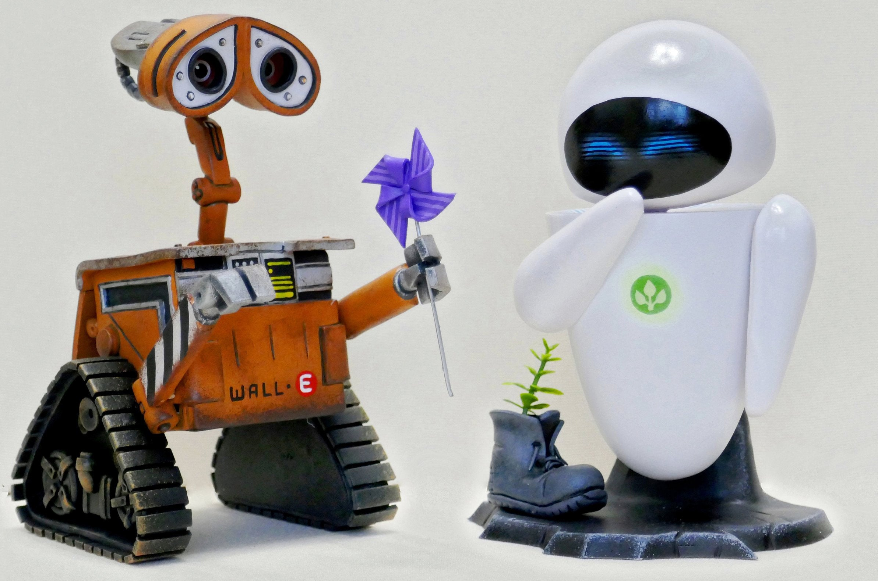
Intelligence

Slide 3
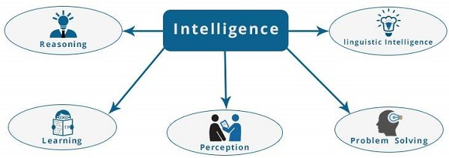
We call ourselves Homo sapiens
Wise Man: Thinking
Intelligence: Perceive, understand, predict, and manipulate a world

Slide 4
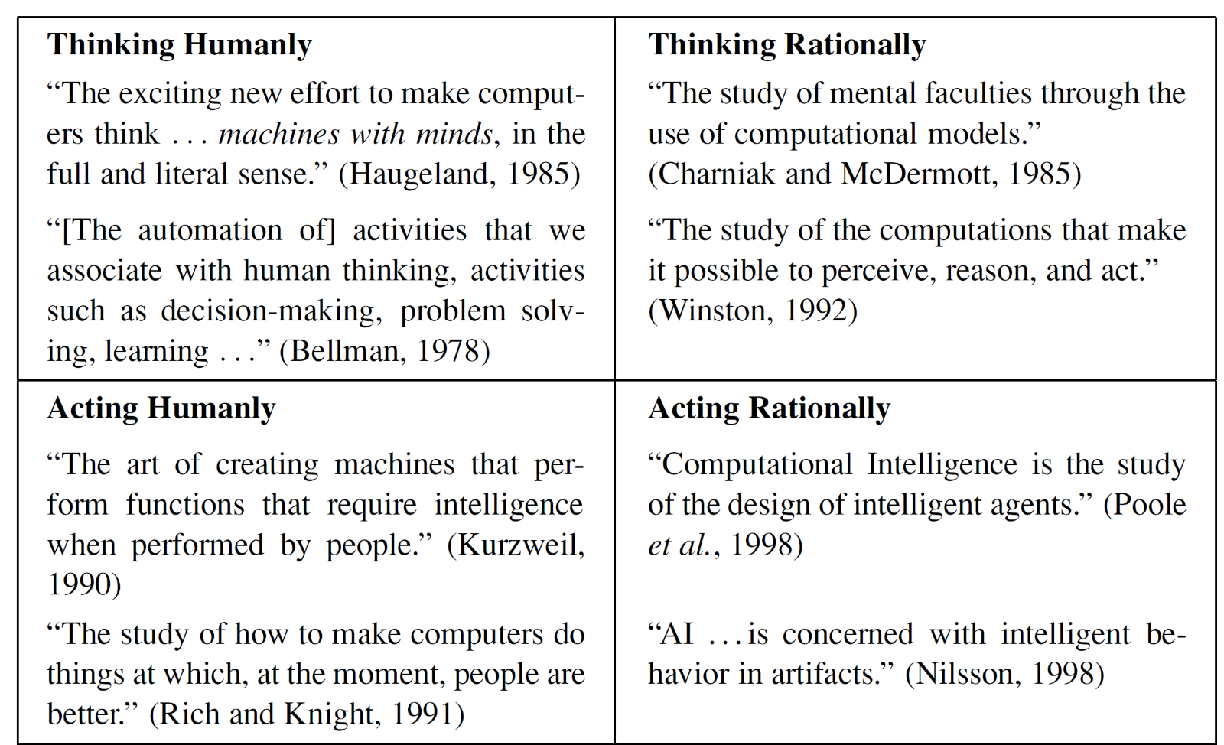
AI definitions

Slide 5
Acting humanly: The Turing Test approach
The Turing test, originally called the imitation game by Alan Turing in 1950, is a test of a machine's ability to exhibit intelligent behaviour equivalent to, or indistinguishable from, that of a human.
Turing proposed that a computer can be said to possess artificial intelligence if it can mimic human responses under specific conditions.
To Acting Humanly, the computer would need to possess the following capabilities:
Natural language processing
Knowledge representation
Automated reasoning
Machine learning
To pass the total Turing Test, the computer will need
COMPUTER VISION • computer vision to perceive objects, and
ROBOTICS • robotics to manipulate objects and move about.

Slide 7
Thinking humanly: The cognitive modeling approach
If we are going to say that a given program thinks like a human, we must have some way of determining how humans think. We need to get inside the actual workings of human minds.
There are three ways to do this: through introspection—trying to catch our own thoughts as they go by; through psychological experiments—observing a person in action; and through brain imaging—observing the brain in action.
Once we have a sufficiently precise theory of the mind, it becomes possible to express the theory as a computer program.
If the program’s input–output behavior matches corresponding human behavior, that is evidence that some of the program’s mechanisms could also be operating in humans.

Slide 8
Thinking rationally: The “laws of thought” approach
The Greek philosopher Aristotle was one of the first to attempt to codify “right thinking,” that is, irrefutable reasoning processes.
Patterns for argument structures that always yielded correct conclusions.
For example, “Socrates is a man; all men are mortal; therefore, Socrates is mortal.”
These laws of thought were supposed to govern the operation of the mind; their study initiated the field called logic.

Slide 9
Acting rationally: The rational agent approach
An agent is just something that acts.
Of course, all computer programs do something, but computer agents are expected to do more:
operate autonomously
perceive their environment
persist over a prolonged time period
adapt to change
create and pursue goals.
A rational agent is one that acts so as to achieve the best outcome or, when there is uncertainty, the best expected outcome.

Slide 10
Intelligence by different branches
We discuss disciplines that contributed ideas, viewpoints, and techniques to AI.
Philosophy
Mathematics
Neuroscience
Psychology
Computer engineering
Control theory
Linguistics

Slide 11
Philosophy
Can formal rules be used to draw valid conclusions?
How does the mind arise from a physical brain?
Where does knowledge come from?
How does knowledge lead to action?
Aristotle (384–322 B.C.) was the first to formulate a precise set of laws governing the rational part of the mind. He developed an informal system of syllogisms for proper reasoning, which in principle allowed one to generate conclusions.
Ren´e Descartes (1596–1650) gave the first clear discussion of the distinction between mind and matter and of the problems that arise.
He held that there is a part of the human mind (or soul or spirit) that is outside of nature, exempt from physical laws.
The final element in the philosophical picture of the mind is the connection between knowledge and action. This question is vital to AI because intelligence requires action as well as reasoning.

Slide 12
Mathematics
What are the mathematical formal rules to draw valid conclusions?
What can be computed?
How do we reason with uncertain information?
Philosophers staked out some of the fundamental ideas of AI, but the leap to a formal science required a level of mathematical formalization in three fundamental areas: logic, computation, and probability.
Thomas Bayes (1702–1761) proposed a rule for updating probabilities in the light of new evidence. Bayes’ rule underlies most modern approaches to uncertain reasoning in AI systems
The idea of formal logic can be traced back to the philosophers of ancient Greece, but its mathematical development really began with the work of George Boole (1815–1864), who worked out the details of propositional, or Boolean, logic (Boole, 1847).

Slide 13
Neuroscience
How do brains process information?
Neuroscience is the study of the nervous system, particularly the brain.
The measurement of intact brain activity began in 1929 with the invention by Hans Berger of the electroencephalograph (EEG).
The recent development of functional magnetic resonance imaging (fMRI) (Ogawa et al., 1990; Cabeza and Nyberg, 2001) is giving neuroscientists unprecedentedly detailed images of brain activity, enabling measurements that correspond in interesting ways to ongoing cognitive processes.
Note: Even with a computer of unlimited capacity, we still would not know how to achieve the brain’s level of intelligence.

Slide 14
Computer engineering
How can we build an efficient computer?
For artificial intelligence to succeed, we need two things: intelligence and an artifact.
The computer has been the artifact of choice. The first operational computer was the electromechanical Heath Robinson, built in 1940 by Alan Turing’s team for a single purpose: deciphering German messages.
Of course, there were calculating devices before the electronic computer.
Charles Babbage (1792–1871) Analytical Engine was far more ambitious: it included addressable memory, stored programs, and conditional jumps.

Slide 15
Control theory
How can artifacts operate under their own control?
Ktesibios of Alexandria (c. 250 B.C.) built the first self-controlling machine: a water clock with a regulator that maintained a constant flow rate. This invention changed the definition of what an artifact could do.
Other examples of self-regulating feedback control systems include the steam engine governor, created by James Watt (1736–1819), and the thermostat, invented by Cornelis Drebbel (1572–1633), who also invented the submarine.
Linguistics
How does language relate to thought?
Understanding language requires an understanding of the subject matter and context, not just an understanding of the structure of sentences.

